Slide 1
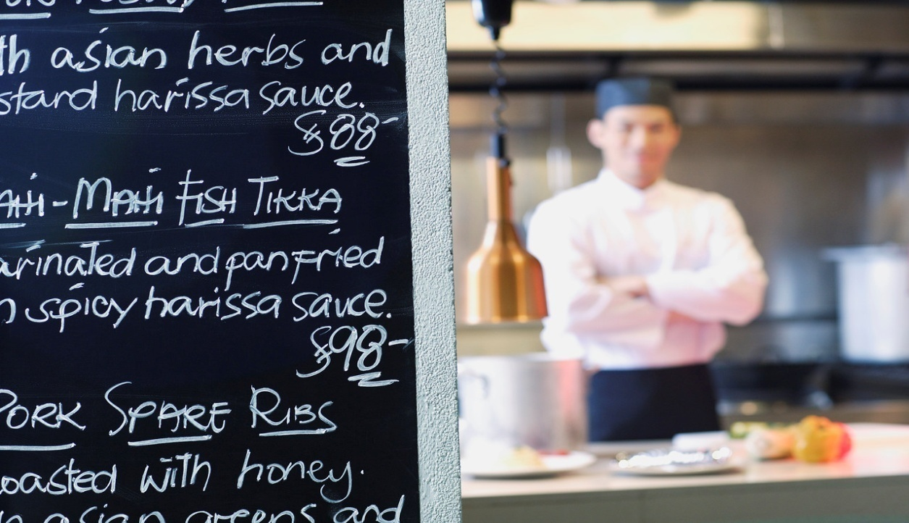
PLAN AND MANAGE MENU-BASED CATERING
D1.HCC.CL2.06
Notes:
Trainer welcomes students to the class and informs them they are learning how to plan and manage menu based catering.

Slide 2

Plan and manage menu based catering
Assessment for this Unit may include:
Oral questions
Written questions
Work projects
Workplace observation of practical skills
Practical exercises
Formal report from employer/supervisor
Notes:
Trainer to Advise:
Trainer advises students that assessment for this Unit may take several forms all of which are aimed at verifying they have achieved competency for the Unit as required.
Trainer indicates to students the methods of assessment that will be applied to them for this Unit.

Slide 3

Plan and manage menu based catering
This unit comprises two elements:
Plan and write menus
Manage menu based catering
Notes:
Trainer advises students this Unit comprises two elements, as listed on the slide explaining:
Each Element comprises a number of Performance Criteria which will be identified throughout the class and explained in detail
Students can obtain more detail from their Trainee Manual
The course presents advice and information but where their workplace requirements differ to what is presented, the workplace practices and standards must be observed.

Slide 4
Plan and manage menu based catering
Element 1: Plan and write menus
Establish the enterprise and/or clients requirements for menu/s
Write menus for enterprise operations
Write menu ensuring menu balance
Prepare menu costing
Produce finished/final menu
Notes:
Trainer to advise:
Trainer to relate performance criteria to element 1
Performance criteria is the process by which the students training match the learning element
The element is the skill
To assess competency in the skill; the performance criteria is used to outline activities that can be used to assess competency.
The trainer should relate how the performance criteria is related to the element
To be able to Plan and manage menu based catering the students must be able to;
Plan and write menus
The student should be able to
Establish the enterprise and/or clients requirements for menu/s
Write menus for enterprise operations
Write menu ensuring menu balance
Prepare menu costing
Produce finished/final menu

Slide 5
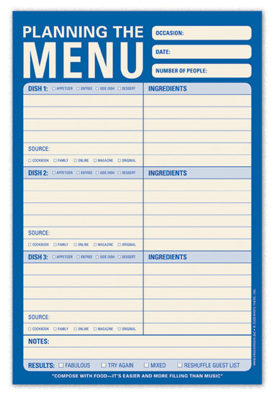
Plan and manage menu based catering
Establish the enterprise and/or the clients requirements for menus:
Fine Dining: A la Carte
Function house
Street cafe
Child care centre
Hospital Catering
Notes:
Trainer to advise:
What is the type of catering supplied and variety of menu required for each
Café: All day Menu; Breakfast; Lunch; Dinner; Morning Tea; Afternoon Tea; High tea
Function Menus: Weddings; Birthday Celebrations; Business Functions; Football Club; Ladies Card playing club
Luxury Hotel: Fine Dining Restaurant; Café Menu; Function Menus; Poolside Kiosk Menu; Bar Menu in Tapas Bar
When the type of catering venue has been established then the menu or menus need to be established that will reflect the values of the establishment.
A luxury 5 star venue will have different values to a street café. This does not demean the quality served by the street café it just means that plastic cutlery is used and people sit on older chairs and tables than they might get when they go to a 5 star establishment.
Customers do not expect to receive the same level of service when purchasing from a street café because they know they will not paying the same price.

Slide 6
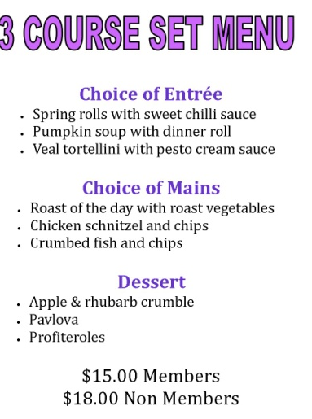
Plan and manage menu based catering
Write menus for enterprise operations
Café - all day menu
A la carte - fine dining
Set menu
Function menu
Notes:
Trainer to advise:
Cafes will normally have the same menu everyday and never change
Some will offer specials on a daily basis
Menus for cafes will have light meals at the start then several larger meals to fulfill needs for all potential customers.
Menu items needs to be quick to prepare and serve as staffing levels in café’s will be less than fine dining restaurants.
A la carte menus will start with entrée’s followed by main courses then desserts.
Some special cuisines like Italian might have a ‘pasta’ section that is served between entrée and mains.
Other names for entrée may be starters; these might be smaller in size
Set Menus;
Set menus will be used in many places. All the term means is that the number of persons that the menu will serve is known before the function starts
The customer chooses from a a menu where there may be 8 entrees, 8 main courses, 6 desserts, cheese course, coffee and tea selection, options for friandises
The customers only gets to choose 2 from each section and the customers may change when the food is served at the table.
100 people for the service
50 of each dish is required maybe 10% more to allow for breakages and spillages during service.

Slide 7
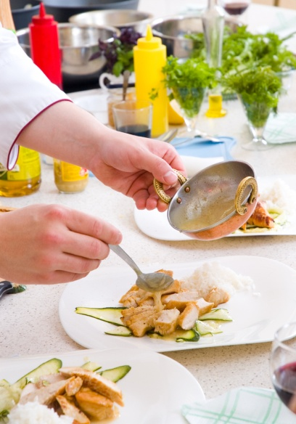
Plan and manage menu based catering
Write menu ensuring menu balance
Choice of ingredients
Balance of styles
Traditional styles
Contemporary
Variety of taste
Notes:
Trainer to advise:
Menu writing is an skill that requires thought and knowledge of ingredient availability and customers requirement
The average restaurant or café will be quite predictable.
Occasionally one get a menu that is different and the chef is testing new flavour combinations.
Writing the menu
What are the market requirements. The ‘market’ is a term used to describe the potential customers.
There will be a blend of meat, fish and poultry dishes. There should be some vegetarian as well.
Cold served dishes as well as hot served dishes.
Small serves as well as larger more complete meals.
Desserts may also be offered, but these maybe just be something sweet like cake or pastries.
Is it formal dining or casual. Is the menu traditional or contemporary. Contemporary being a modern twist to a traditional menu item.

Slide 8

Plan and manage menu based catering
Write menu ensuring menu balance
Student Activity: Students are to write a menu
3 entrées
4 main courses
1 vegetarian; 1 red meat;1 poultry;1 seafood
3 desserts
Notes:
Trainer to advise:
Menu writing is an skill that requires thought and knowledge of ingredient availability and customers requirement
The average restaurant or café will be quite predictable.
Entrees may be hot or cold
Most of main courses will he served hot
Students may work in pairs or by themselves

Slide 9
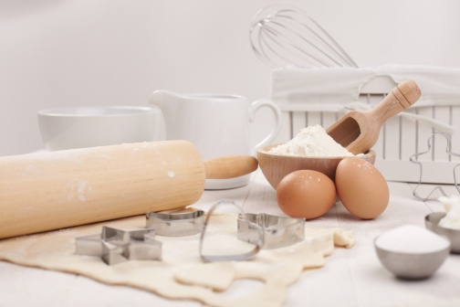

Plan and manage menu based catering
Prepare menu costing
Ingredient cost
Labour Cost: how long does it take to produce the menu elements
Profit Margins
Capital Equipment cost
Notes:
Trainer to advise:
When preparing menu costing all things need to be considered
Initially it is the ingredients for a dish
The time taken to produce a dish
Number of elements required
Complexities of producing each element
How long does it take to produce the dish can be effected by the level of equipment used
When all cost is identified then you have a true cost of production.

Slide 10
Plan and manage menu based catering
Ingredient cost: Garlic Prawns for 10 persons
Ingredient | Weight | Cost unit | Cost Amount Used
Prawn | 800gm | $25 kg | $20.00
Butter | 100gm | $3.85kg | $0.39
Garlic | 80gm | $16.50kg | $1.32
Parsley | ¼ Bunch | $2.00 bch | $0.50
Lemon | 3 | $0.50 ea | $1.50
Total Cost of Dish |  |  | $23.68
Cost per dish ÷10 |  |  | $2.37
Notes:
Trainer to advise:
Several ways to cost
Basic costing is to decide
What is in the dish? Recipe
How much will make a serving? Chef and Enterprise manager to decide
Will base recipe serve 10 people
10 is used because it is easier to multiply base figure: 25 becomes 2.5 times the recipe
Develop recipe for 10 people
Price ingredients against cost of purchasing. Most things are priced by the kilo.
$10.00 per kilo; 385grams is 10 multiply by .385; this equals $3.85
$13.45 per kilo: 385grams is 13.35 multiply by .385; this equal $5.18
After ingredients cost then labour cost needs to be identified but this is priced in the cost of manufacturing.
It should be noted that some dishes take longer to prepare than others.
This is allowed for in averaging

Slide 11

Plan and manage menu based catering
Produce finished or final menu
What is the enterprise theme?
Meet needs of broad customer base
Menu needs to meet cost structure of establishment
Notes:
Trainer to advise:
Student will need to write a contemporary menu with entrée, main course and desserts items.
Working under direction of their Trainer the student will have to construct a menu to fit the needs of the enterprise in which they are working.
Develop a theme
Customer base are meat eaters, vegetarians, seafood eaters, rice eaters,
People with preference for fast service and budget prices
People with the money to spend and an expectation of quality
What is your menu going to reflect?

Slide 12
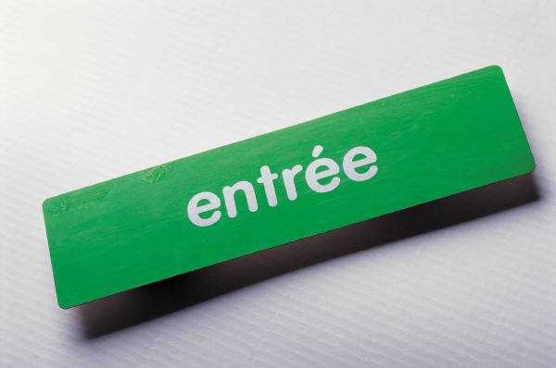
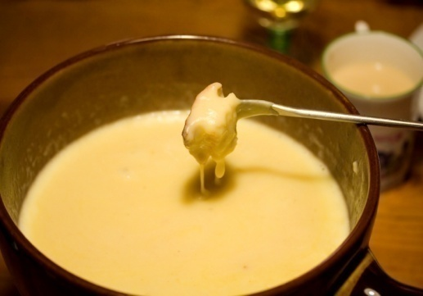
Plan and manage menu based catering
Produce finished or final menu
Entrée
Potato and leek Soup with buttered leek and crab cakes $7.00
Baked Field Mushrooms with mixed salad leaves $8.50
Charcuterie Plate $9.00
Soup of the day $ 6.50
Notes:
Trainer to advise:
Student will need to write a contemporary menu with entrée, main course and desserts items.
Working under direction of their Trainer the student will have to construct a menu to fit the needs of the enterprise in which they are working.
Many restaurants have menus online so students can access this rich resource for inspiration.
Remember:
what sells well in one area may not sell well in another.
Entrees:
Light, not too heavy
Allow for all types of diners

Slide 13
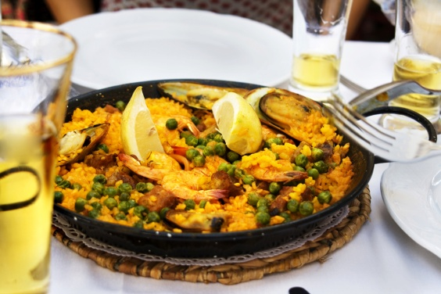
Plan and manage menu based catering
Produce finished or final menu
Mains
Chermoula crusted fish with pan fried lentils and potato chips $15.00
Veal Involtini with salsa verde on polenta and Roasted Vegetables $18.50
Slow cooked Thai flavoured lamb shanks on pumpkin puree $21.50
Kangaroo Burger with oven roasted beetroot and pineapple $18.00
Chicken and Pesto Sandwich toasted served with Vietnamese salad $ 19.50
Notes:
Trainer to advise:
Student will need to write a contemporary menu with entrée, main course and desserts items.
Working under direction of their Trainer the student will have to construct a menu to fit the needs of the enterprise in which they are working.
Mains:
Most customers will have a main course
Not all will have an entrée
Not all will have a dessert
This is where 80% of your extra sales will be from

Slide 14
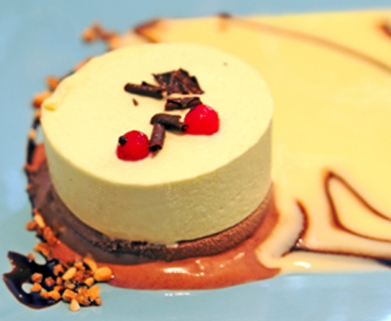
Plan and manage menu based catering
Produce finished or final menu
Desserts
Coffee pannacotta with almond tuilles $9.00
Flourless Chocolate cake served with oven roasted pear $8.50
Lemon Delicious Pudding $7.00
Apple and Rhubarb Grunt served with clotted cream $8.00
Notes:
Trainer to advise:
Student will need to write a contemporary menu with entrée, main course and desserts items.
Working under direction of their Trainer the student will have to construct a menu to fit the needs of the enterprise in which they are working.
Not all are going to have desserts
Selling a dessert as well as entrée and main course will be the most profitable dish.
What is this so?
When customers sit at a table in a restaurant then they have used the tablecloth and has to be changed when they leave
The more that is served to them the lesser the cost of the table per course
If they purchase 3 courses then more money has been made from that one sitting than if they have just an entrée then leave.

Slide 15
Plan and manage menu based catering
Element 2: Manage menu based catering
Select and use appropriate catering control
Control labour costs
Optimise product usage
Apply stock control measures
Plan production schedules
Notes:
Trainer to advise:
Trainer to relate performance criteria to element 2
Performance criteria is the process by which the students training match the learning element
The element is the skill
To assess competency in the skill; the performance criteria is used to outline activities that can be used to assess competency.
The trainer should relate how the performance criteria is related to the element
To be able to Plan and manage menu based catering the students must be able to;
Manage menu based catering
The student should be able to
Select and use appropriate catering control
Control labour costs
Optimise product usage
Apply stock control measures
Plan production schedules

Slide 16
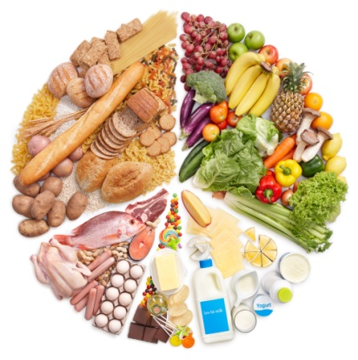
Plan and manage menu based catering
Appropriate Control
Control of cost
Control of labour skill levels
Control of food cost
Control of equipment cost
Adapting to market changes
Notes:
Trainer to advise:
Control is about Knowledge
What are the costs?
All costs need to be understood if the correct charges are to be applied.
A menu dish may be popular but is the return to the enterprise sufficient to cover the true cost of manufacturing
Where can they be controlled?
Accurate control of menu production is required.
Are staff all working to same formula? Are some staff using more to produce same quantities.
Serving sizes are all the same: These can be averaged but average serving sizes
How can they be controlled?
Working to standard recipes
Training of staff
Auditing of processes
Mentoring of staff development
Utilising leftover trimmings in other dishes

Slide 17
Plan and manage menu based catering
Select and use appropriate catering control
Food ordering system
Handwritten documents
Computerised system
Easy to keep track of incoming stock
Easier to keep costs under control
Notes:
Trainer to advise:
System of food ordering and purchasing agreement for specific time periods
Modern methods of computerised ordering makes ordering much simpler.
Smaller premises may have to order by handwritten documents so it is important to keep records of what is ordered.
Ledger books with pre ruled lines are fine examples that can be adapted for hand written document
Students are encouraged to adopt modern methods of computerised ordering.

Slide 18
Plan and manage menu based catering
Select and use appropriate catering control
Skill level of staff
Training
Versatility of staff
Auditing of skill levels
Continual improvement of skill levels
Notes:
Trainer to advise:
Skill level of the staff will be paramount when deciding on the theme of the enterprise.
Are they prepared to cook food different to what they know?
Do they understand the different techniques required?
Conduct an audit of staff skill levels; do not assume they know
What training has been done by the enterprise?
Do all staff know what to do in event of fire in kitchen
Where are extinguishers
What type of extinguishers are available; foam, powder???????
Where is gas shut off valve
Do staff know how to stop bleeding resulting from cuts with sharp objects?
Can they all apply bandages for simple first aid until medical specialists can be summoned?
Skills is not always about the cooking
Cooking skills mean versatility. The more they can do the more flexible they are to the kitchen work.
Training of staff is ongoing and continual

Slide 19
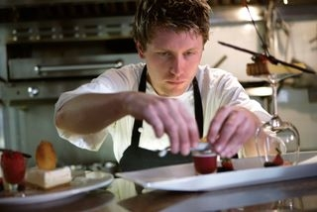
Plan and manage menu based catering
Select and use appropriate catering control
Cooking System
Cooking to standard recipe
Costing to standard recipes
Control of costs
Dealing with suppliers
Portion control
Process control
Notes:
Trainer to advise:
All staff need to be cooking product the same way
Working to same recipe and method of production

Slide 20

Plan and manage menu based catering
Control labour costs
How many staff are required to produce required menu items?
How much are they paid per hour?
What other benefits do they have?
Are they productive all the time?
Notes:
Trainer to advise:
Labour is a big cost in any kitchen. It is not just the cost of how much per hour staff are paid but also the on cost.
Are they supplied lunch, tea and coffee facilities, laundry allowances, medical insurance and benefits.
These may not all be required in your kitchen but all needs to be looked at if you are in charge of paying staff all correct allowances.
Having staff that are not needed is an expensive error.
Not having enough staff can be expensive if customers walk out because they have not been served quick enough.

Slide 21

Plan and manage menu based catering
Optimise product usage
Purchasing what is required
Yield testing of ingredients
Yield testing of recipes
Utilising excess stock
Notes:
Trainer to advise:
Purchasing for a la carte is very difficult as exact numbers that may be required is the great unknown.
Averaging of purchasing and record keeping are the best ways of controlling build up of excess stock
When a kilo of onions are peeled; how much usable flesh is available
When a kilo of peeled onions are sliced; how much sliced onion is achieved
When a kilo of onions are diced; how much usable product is achieved
When the lamb casserole is finally cooked;
how many serves are actually available for service?
what is the average size of the serving?
Nothing is ever going to be set; averaging will always have to be used.
Some things can be controlled more than others
There must be control so it is important to understand where they can be controlled and when is the best time to put these controls in place.

Slide 22
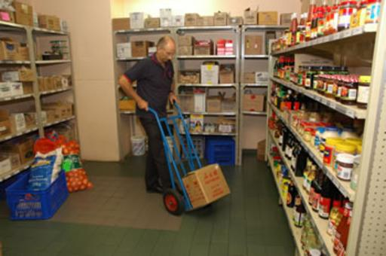
Plan and manage menu based catering
Apply stock control measures
Control from the beginning:
Has this product been ordered?
Is Quantity correct?
Is Quality correct?
Notes:
Trainer to advise:
When receiving the stock that has been ordered it is important to check that it is what was ordered.
If this is not started here then control has been lost and people will be trying to present a menu items with ingredients that may not be of the same quality standard previously used.

Slide 23

Plan and manage menu based catering
Apply stock control measures
Who is taking stock from store room?
To where is it being taken?
Does that stock arrive at the correct destination?
Implement usage of documentation for stock control
Notes:
Trainer to advise:
Larger establishments will have more control measures in place than smaller premises.
Larger establishments will have a greater risk of theft and pilfering than smaller places
Where larger quantities are stored there will be more temptation to take just one and not think it will be missed than in smaller establishments.
Stock control measure will be in place in larger establishments that have multiple kitchens.
Internal dockets of stock transfers with delivery dockets and stock being signed and accepted

Slide 24
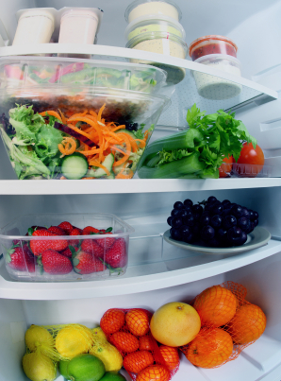

Plan and manage menu based catering
Apply stock control measures
Amount of stock received
Number of serving of each menu item sold
Amount of waste from each section
Old stock
Breakages and accidents
Notes:
Trainer to advise:
As stock is dispersed around the establishment there needs to be a check on stock usage.
In a perfect world it would all match
Food for 50 serves in: 50 serves out: 50 sales; maximum profit
Where people are involved there will be accidents
Where people are involved in portioning there will be less correct serves
20 mils of sauce per person from 1 liter of sauce= 50 serves
Actual number of serves may be as low as 40, average 45 serves would be considered acceptable.
Allow for contingencies but what is acceptable??
Good management of ordering more than what is required always to allow for extras allows for possibility of excess stock building up.
Small satellite kitchens needs to be cleaned out of all excess stock and sent to area for stock to be used.
Normally staff meals section
Breakages and accidents will happen.
Sometimes human failings, sometime mechanical failings.

Slide 25
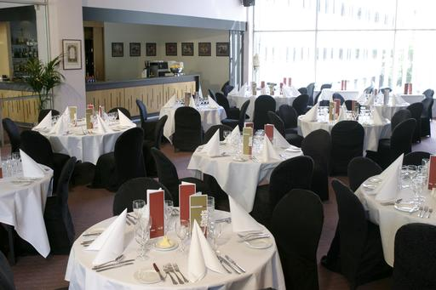
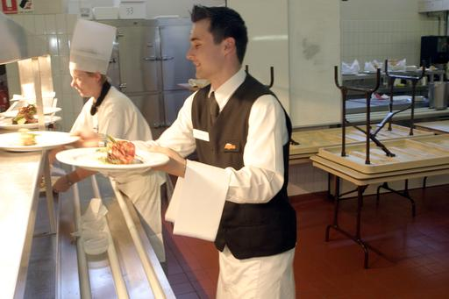
Plan and manage menu based catering
Plan production schedules
How much needs to be produced?
Production capabilities of the equipment
Skill level of the staff
Storage facilities of the kitchen
How many staff will be required to meet demand?
Notes:
Trainer to advise:
Production schedules are based around how food needs to be produced to match expected number of sales.
Food production needs time to be allocated depending on the type of food being produced and the processing required to produce said food.
Acquisition of the required stock
Preparation of each ingredient; time required for each step in the process
Special equipment that may be required.
Planning production schedules is complex and allowances must be made for when staff do not turn up to work at required time.

